Slide 1
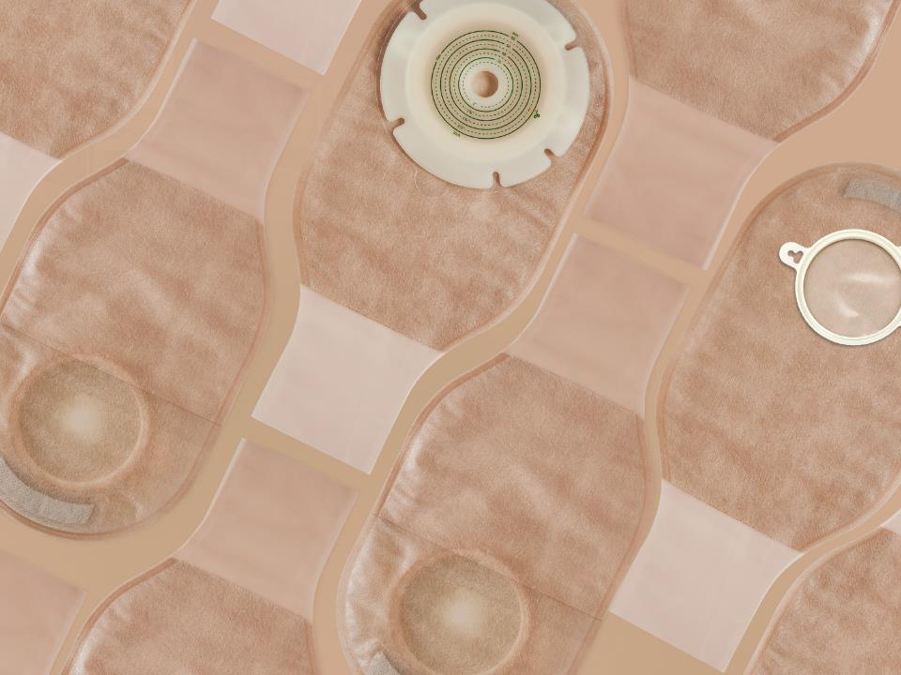

Ostomy Care Series
Two-Piece Urostomy Bag
Shanghai Joy Crown Industry Co., Ltd

Slide 2


What is an ostomy?
People who have ostomy surgery, usually with disease or cancer of the large bowel or rectum. During clinical treatment, an opening in the abdomen will be surgically used as a drainage channel to replace the anus. This opening is called an artificial stoma or artificial anus, it is called a stoma.
If an artificial stoma is made due to a disease of the urinary system, it is called a urostomy.

Slide 3
What is an ostomy bag?
According to the different stoma, the ostomy bag can be divided into Colostomy bag and urostomy bag.
An ostomy bag is used to store feces excreted by a stoma patient through the stoma，The ostomy bag is composed of a barrier and a bag body, the barrier makes the ostomy bag stick to the human body, and the bag body is used to store feces.
The bag body and barrier can be one piece, which is called a one-piece ostomy bag. The bag body and barrier can also be split, which is called a two-piece ostomy bag.
The ostomy bag can be divided into an open pocket and a closed pocket. The open pocket can discharge feces at any time through the opening of the bag body, and the closed pocket can be discarded when it is full, which is convenient to use.

Slide 4
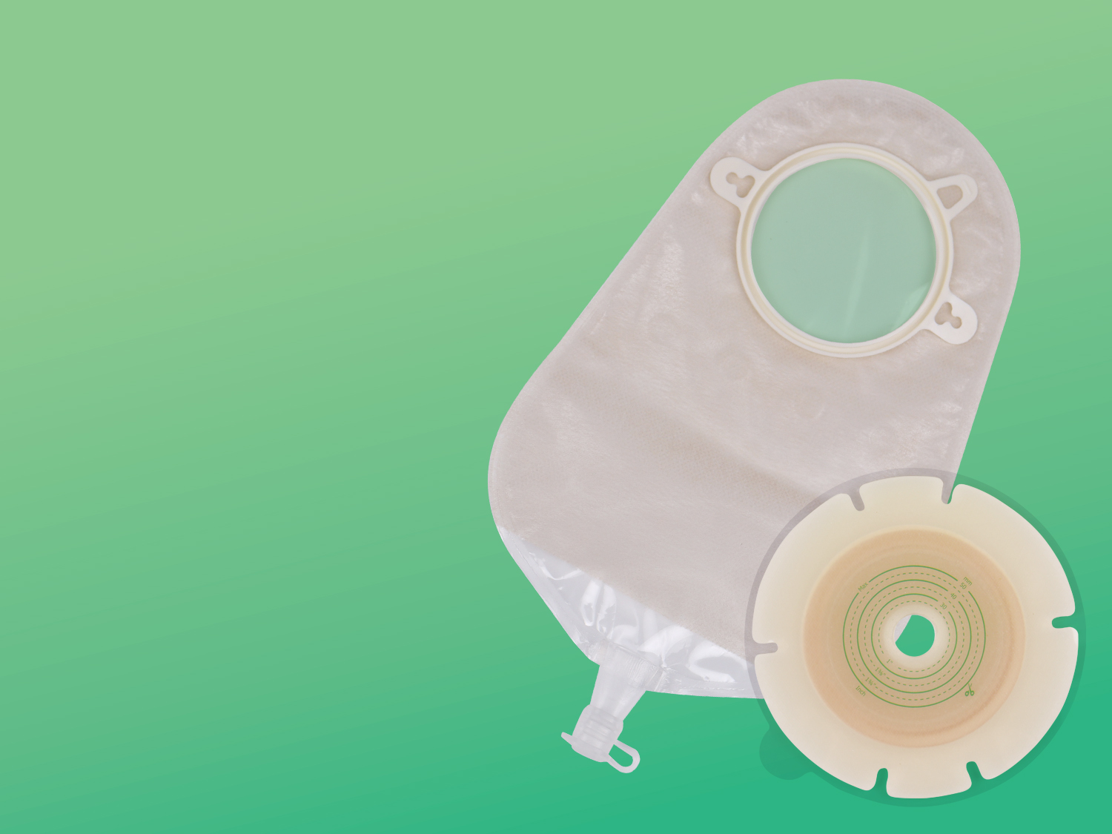
The Characteristics And Advantages Of Urostomy Bag
Snap Ring
Hydrocolloid barrier with unique formula and special design
Soft and comfortable ultra-thin non-woven outer lining
Flexible, Sealed bag
Soft and tough plastic snap ring and drain valve for good airtightness
Outer Lining Non-woven Fabric
Hydrocolloid Barrier
The experiment shows that the product is frmly pasted and is not afraid of leakage
The Drain Valve

Slide 5
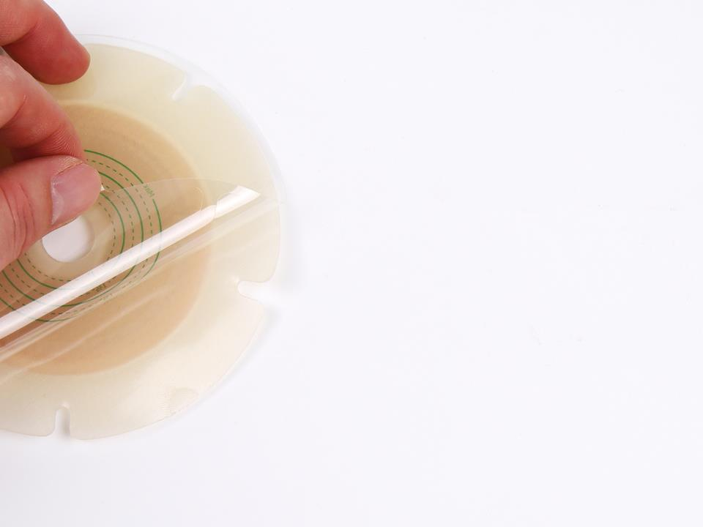
Hydrocolloid Barrier
Using medical hydrocolloid material, with no irritation and extremely low allergy rate.
Special hydrocolloid formula, with strong adhesive and safe and reliable.
Soft and comfortable, with radial incisions designed to conform to wrinkled skin with physical activity.
Easy to replace and clean.
Effectively absorbs the sweat produced by the skin, keeps it fresh and does not irritate the skin.

Slide 6
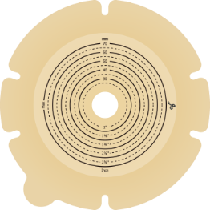
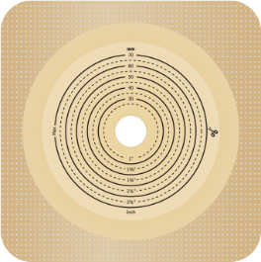
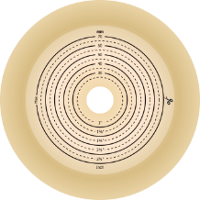
Three Barrier Styles To Fit Every Type Of Stoma
Hydrocolloid barrier
Hydrocolloid barrier
with tape border
Convex barrier

Slide 7
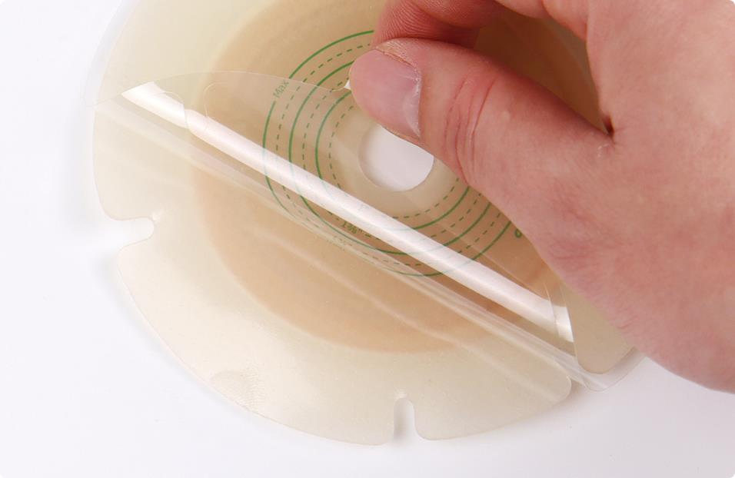
Hydrocolloid Barrier

Slide 8
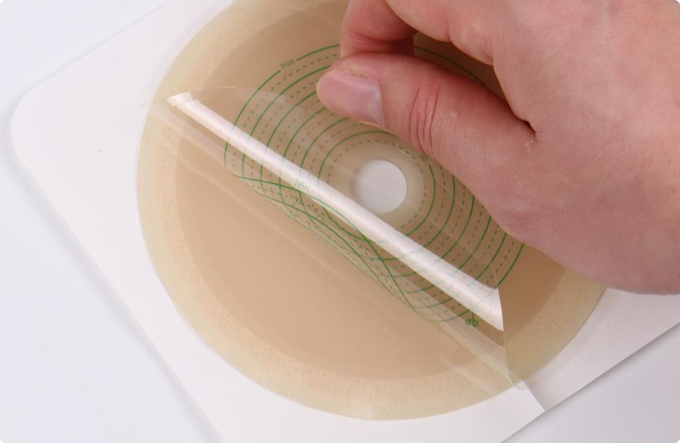
Hydrocolloid Barrier With Tape Border

Slide 9
Convex barrier

Slide 10
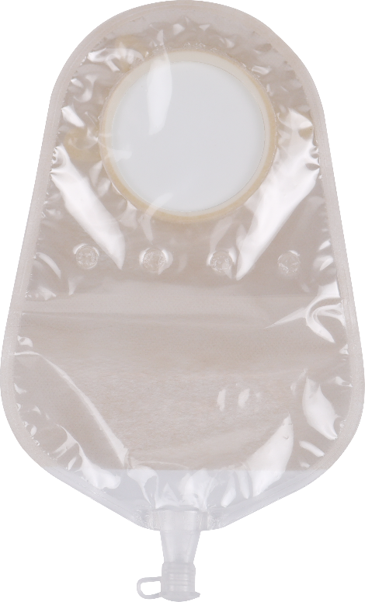

The Bag Body
* High barrier film, soft and strong
*Good airtightness and no leakage

Slide 11

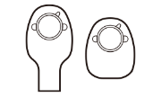
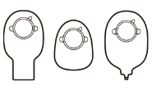
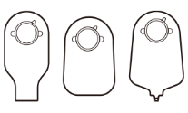

A Variety Of Bag Styles Are Available For Patients Of Different Ages
Neonate
Children
Adult
Larger Size

Slide 12
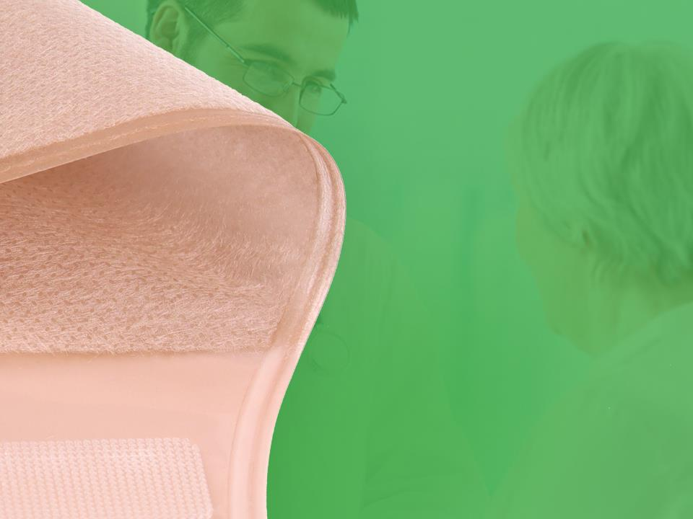
Outer Lining Non-woven
Fabric
Ultra-thin non-woven fabric, soft and comfortable
Waterproof fabric that stays fresh for a long time
Two colors available: skin color and white color

Slide 13
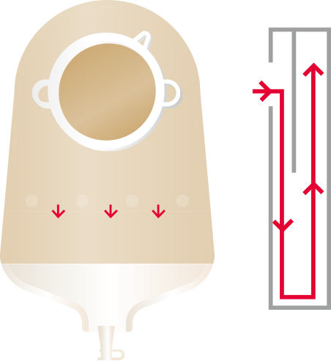
Schematic Diagram Of Anti-backflow Device
The anti-reflux device can prevent urine from flowing back to the top of the stoma bag and erode the skin around the stoma, effectively avoiding skin allergies and ulcers caused by soaking the skin around the stoma, and ensuring the comfort of use.

Slide 14

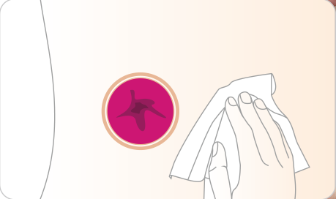
User Guide For Two-piece Urostomy Bag
1. Wash the skin around the stoma with warm water or
saline and wait for the skin to dry.

Slide 15
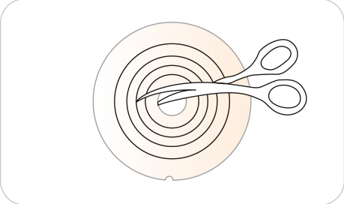
User Guide For Two-piece Urostomy Bag
2. Measure your stoma and cut the barrier to the
appropriate size/shape.

Slide 16
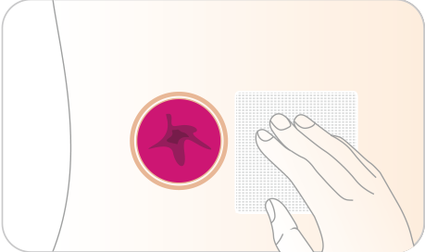
User Guide For Two-piece Urostomy Bag
3. You can choose to place gauze on the stoma to
prevent feces and exudates from flowing out when
pasting the hydrocolloid barrier.

Slide 17
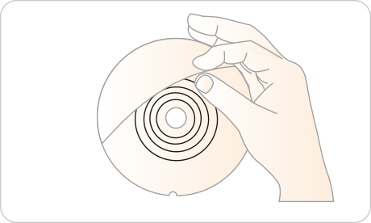
User Guide For Two-piece Urostomy Bag
4. Peel off the PET protective film from the barrier to expose the hydrocolloid adhesive.

Slide 18
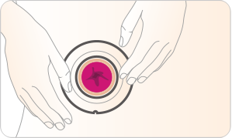
User Guide For Two-piece Urostomy Bag
5. Put the hydrocolloid barrier with the stoma and
apply pressure so that it adheres completely to
the skin

Slide 19
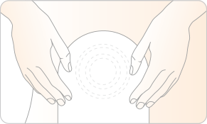
User Guide For Two-piece Urostomy Bag
6. Fix the bag on the hydrocolloid barrier, and pull the bag to see if the two are securely combined

Slide 20
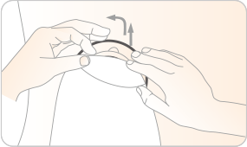
User Guide For Two-piece Urostomy Bag
7. Conveniently remove the bag through the pull ring
for cleaning or replacement.

Slide 21
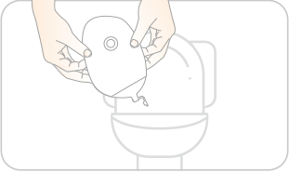
User Guide For Two-piece Urostomy Bag
8. Unplug the drain valve, empty the urine in the toilet,
close the drain valve again, and continue to use the
urostomy bag

Slide 22
Caution
1. It is used in patients with a urostomy.
2. The hydrocolloid barrier can usually be used for 3 to 7 days, and continuous use will affect the adhesion ability. The bag can be reused after being cleaned.
3. The hydrocolloid barrier cannot be reused.
4. The urostomy bag should not be thrown directly into the toilet or sewer, nor should it be discarded casually. Please pay attention to environmental protection.
5. Patients allergenic to adhesive should use it with caution.

Slide 23

THANK YOU!
Shanghai Joy Crown Industry Co., Ltd

